Slide 1

Home Hub To order/search for services, repair, tools etc..
By
Vishal Arockiasamy
Manish Ganapathy Subramanian Bharatwaj
Hariharan Sankar

Slide 2


Progress
Project skeleton
Downloaded data from Yelp API(Used Python).
Downloaded product dataset from internet for product and tools.
Stored downloaded data to MYSQL(Used Python).
Created MongoDB for storing reviews for services and tools.
Login and Registration page is done.
Populated data of service providers and tools
Buy a service or tool.

Slide 3
Currently Working on:
Location based search and search autocomplete feature.
Adding service to favorites.
Analytics.
Features for user profile.
Sending confirmation mail to customers.
Product recommendation using machine learning.

Slide 4
Backlog
Heatmap and Neo4J
Payment and delivery/pickup.
Working on the feedbacks.
UI Changes
Bug fixes

Slide 5
Database
MYSQL Tables:
Users
Services
Tools
Transactions
Customer
Orders
MongoDB Collections:
Service_provider_reviews
Tool_reviews

Slide 6
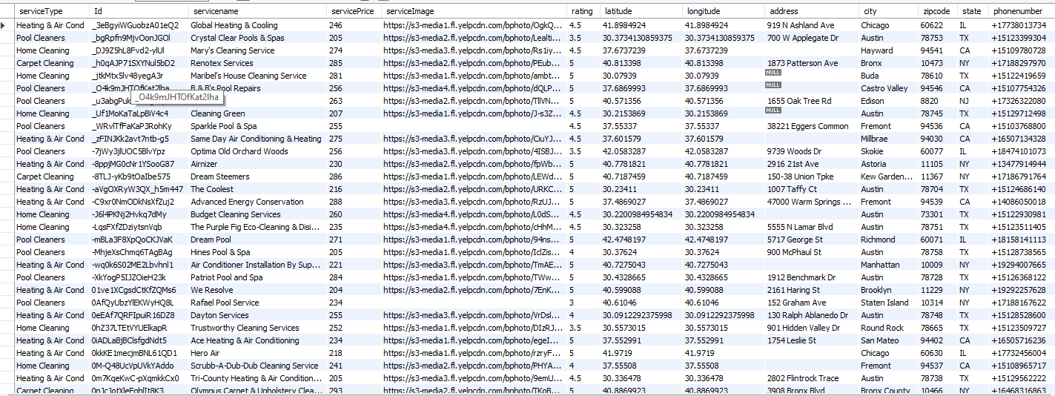
Services Table Format

Slide 7

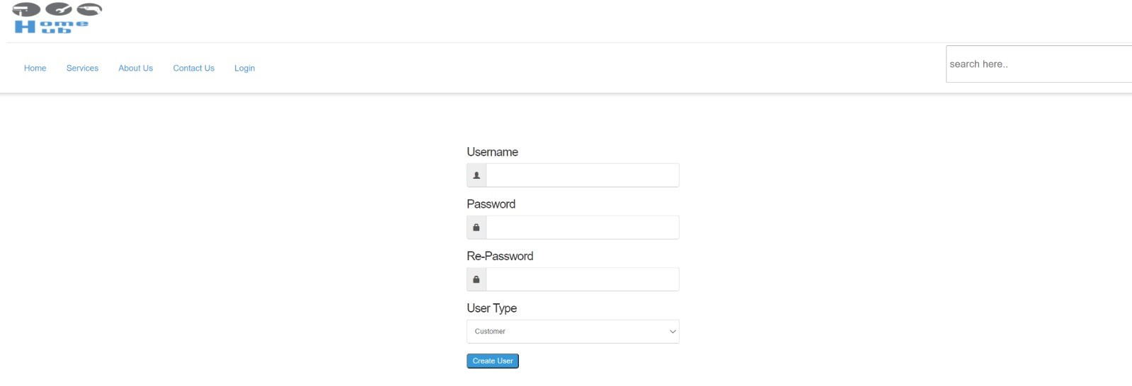
Screenshots: Login and Register

Slide 8
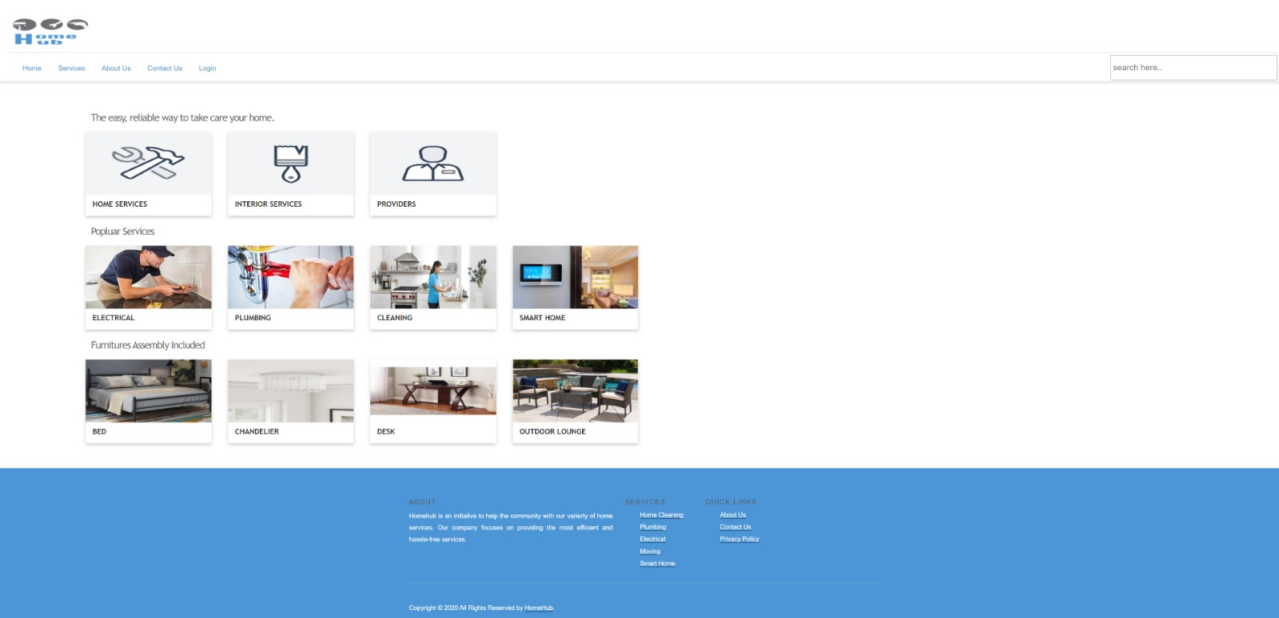
Screenshots: Home Page

Slide 9
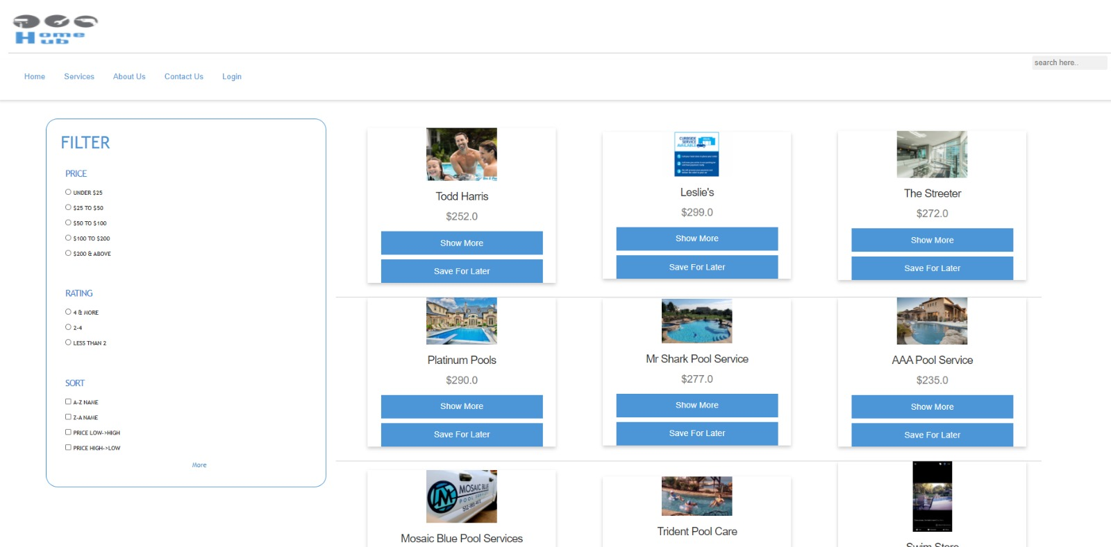
Screenshots: Services page

Slide 10
Thank you!

